Slide 1
Web basics
www.devbridge.com
Sourcery Academy

Slide 2
Agenda
60 min
Html, CSS, Q&A, Practice
60 min
JavaScript, Q&A, Practice
60 min
Practice
Notes:
PART I
General intro Html + CSS + JS
Html: Elements, Html5, block vs inline
CSS: Selectors, opacity, visibility, twitter bootstrap
Practice
Q&A
PART II
Intro to JavaScript, types, functions
Advanced topics, DOM, BOM, forms, V8 engine, API basics, events
Practice
Q&A
PART III
Practice
Homework tasks
Q&A

Slide 3
Intro to HTML
First version in 1989 by Tim Berners-Lee
Current version HTML - 5.0
A Markup language for creating web pages
Notes:
Was initially created by Tim Berners-Lee, then his version was updated by IETF ir W3C
The purpose is to provide a language to make web pages that can be accessed using HTTP protocol
Current version HTML5
It is used together with CSS and JS to make a dynamic and visually appealing webpages.
HTML - for structure and semantic
CSS – visual representation
JS - functionality

Slide 4
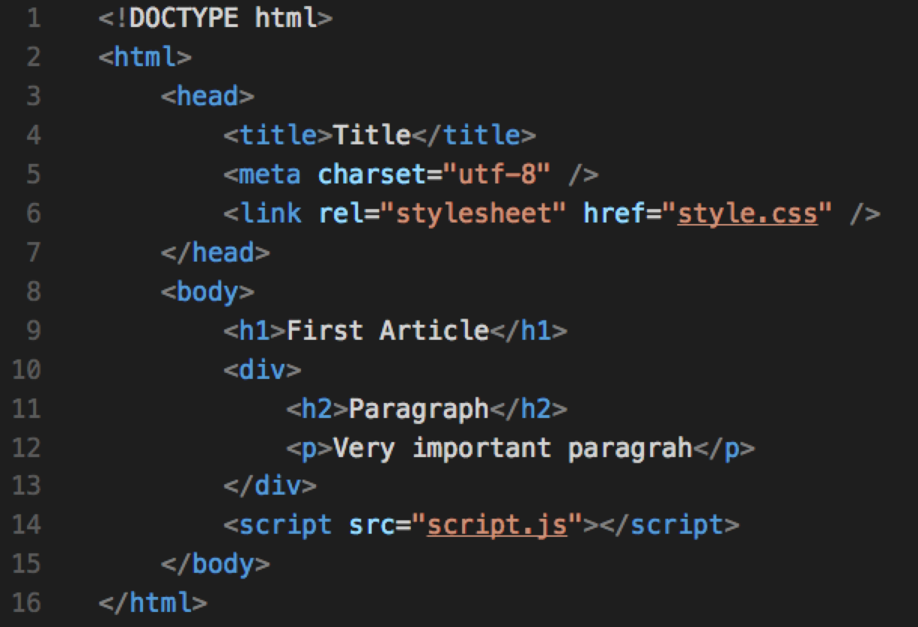
Example
Notes:
Quick overview
Why we need DOCTYPE?
Describe purpose of head, body

Slide 5
Html Tag

Slide 6
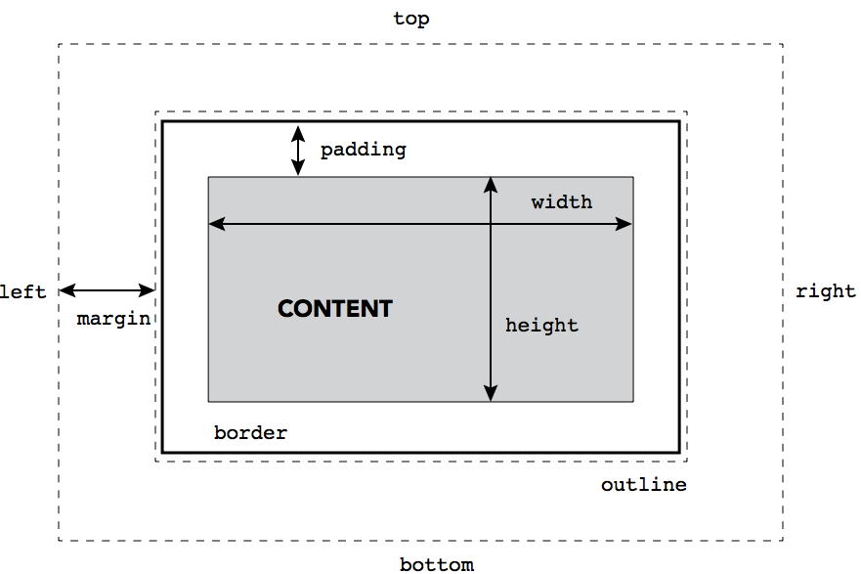
Element types
Inline element
a, img, span, label, input, button …
Block element
div, h1, header, section, footer, nav..

Slide 7
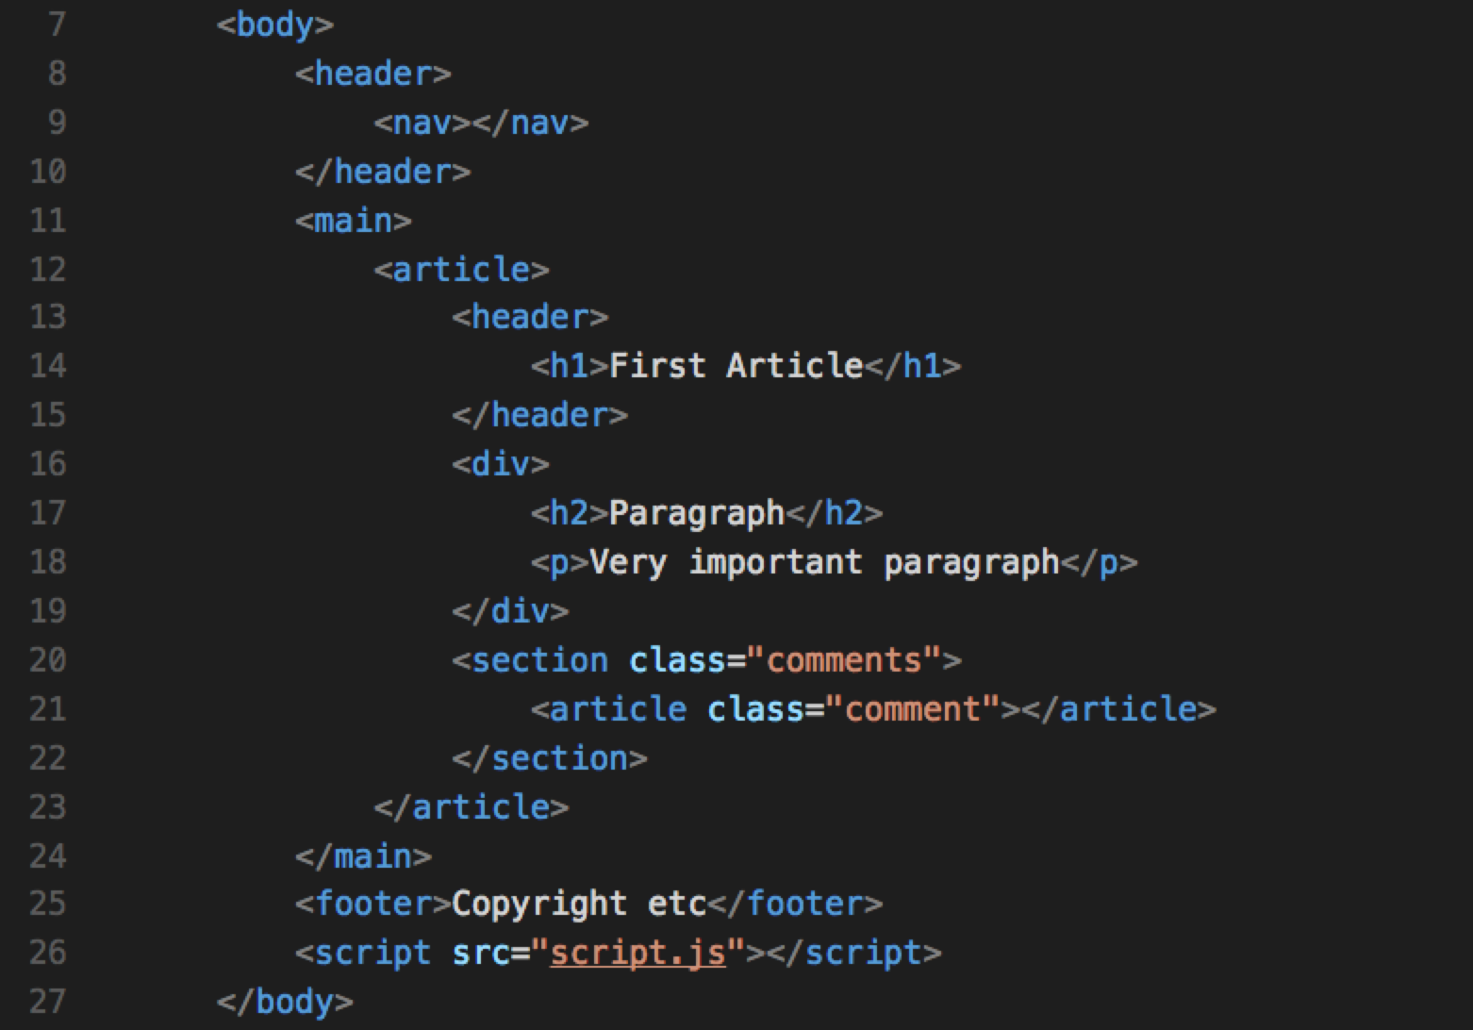
HTML5 semantic tags
Notes:
Header - is used to represent the introductory content to an article or web page
Includes: h1-h6, table of contents, nav, search form
Main - is designed to show screenreaders and assistive technologies exactly where main content begins. Skipping header, navigation, footer etc
Footer - a footer part of an element
Includes: who wrote it, links to related documents, copyright, sitemap, contacts
Section - Used to either group different articles into different purposes or subjects, or to define the different sections of a single article.
Article - is for containing related individual standalone pieces of content, such as individual blog posts, videos, images or news items. Think of it this way : if you have a number of items of content, each of which would be suitable for reading on their own, and would make sense to syndicate as separate items in an RSS feed then use article
Ex: forum post, article, a blog entry
Aside - a section for content that is not the primary focus of an article but is still related to the article.
If used outside - corresponds to advertising and other secondary content
Outside article ex: blogroll, groups of additional navigation, advertising
Inside article ex: pull-quotes, a glossary or even related links.
Nav - a section for navigation

Slide 8
Browser flow
Notes:
HTTP GET -> HTTP POST,
GET THE HTML
Other files downloaded: CSS, JS, IMG
HTML -> DOM + Styles -> Layout
JS executed when parsed, so we use DOMContentLoaded, or load events to start executing code only when DOM is completely loaded

Slide 9
Intro to CSS
First release December 17, 1996
Current version CSS3
To enable the separation of document content from document presentation

Slide 10
Selectors

Slide 11
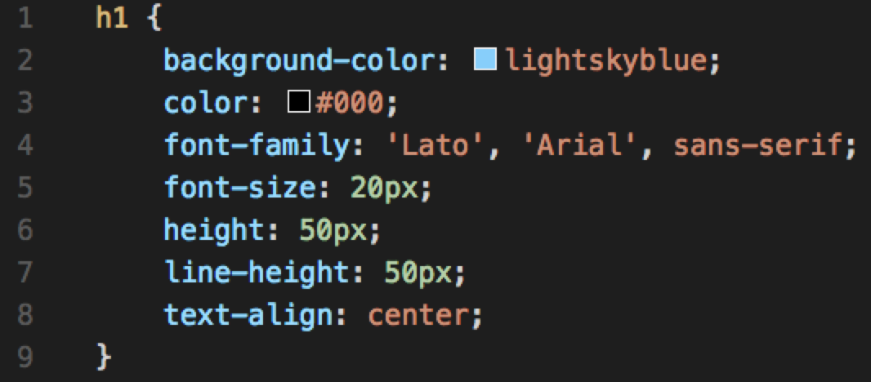
Example
Notes:
Note: Best practice to organize properties by alphabet

Slide 12
Selector patterns
.class – elements with “class” attribute
#id – define an id selector
E F - descendant
E > F - child
E + F - immediately preceded

Slide 13
CSS cascade
User agent defined styles
Inline style sheet (style attribute on HTML node)
Internal style sheet (<style> in <head>)
External style sheet (@import <link>)

Slide 14
CSS specifity
1000 "style attribute used"
100 id
10 attributes and pseudo-classes
1 elements and pseudo-elements

Slide 15
CSS positioning
Display
Static
Relative
Fixed
Absolute

Slide 16
Box model
Notes:
Show html-omni food example?

Slide 17
Twitter bootstrap
Why?
Global CSS settings, fundamental HTML elements styled
Reusable components
Layout grid provided
Notes:
Show life link: http://getbootstrap.com/components/

Slide 18
Q&A

Slide 19
Practice
todo-app-html-starter
Add style for html elements.
Can use Twitter Bootstrap
Own styles
Mixture of both

Slide 20
Javascript intro
First version on December 4, 1995, by Brendan Eich
Current version ECMAScript 2016
Notes:
Developed by Netscape
Mocha -> LifeScript -> JavaScript
Microsoft reverse engineered Jscript for IE3
Ajax – made a difference

Slide 21
JavaScript features
Dynamic language
Prototype-based
First class functions
Notes:
Javascript
Is a high-level, dynamic, untyped, prototype-based with first class variadic functions programming language
Interpreted language
Executes code directly, without compiling a program into machine-language instructions
NOTE: Modern js engines use JIT compilation instead
A JIT compiler runs after the program has started and compiles the code (usually bytecode or some kind of VM instructions) on the fly (or just-in-time, as it's called) into a form that's usually faster, typically the host CPU's native instruction set. A JIT has access to dynamic runtime information whereas a standard compiler doesn't and can make better optimizations like inlining functions that are used frequently. (ref)
Dynamic language
Language that execute many common programming behaviors that static programming languages perform during compilation
Can add new code, extend objects and definitions, or by modify the type system at runtime
Prototype-based
OOP style in which inheritance is performed via a process of cloning existing objects that serve as prototypes
First class functions
Functions that can be treated as a variables used as an argumet, asigned or returned.
Variadic functions
Functions that can have unfixed set of arguments

Slide 22
JavaScript Types
Primitive Types
Object Types
Numbers
Primitive Types
Strings
Key
Value
Object Types
Booleans
Key
Value
null
…
undefined

Slide 23
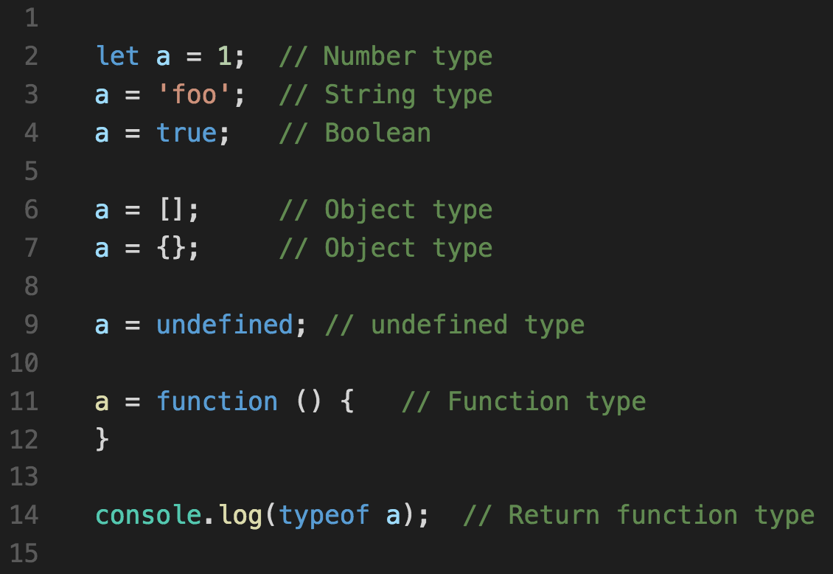
Loose typing
Notes:
It’s dynamically typed Variables and object properties can always hold values of any type.

Slide 24
First class function objects
May be passed as an argument to a function
May be returned from a function
May assigned to a variable
May be stored in an object or array
Have properties

Slide 25
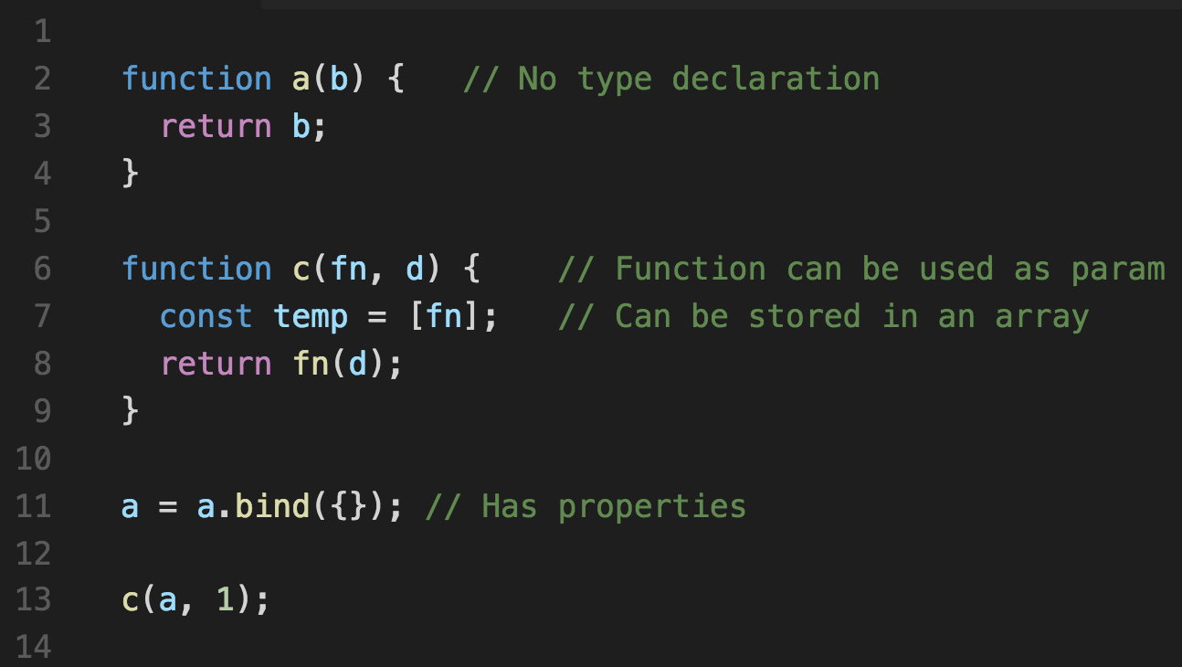
First class function objects
Notes:
May be passed as an argument to a function
May be returned from a function
May assigned to a variable
May be stored in an object or array
Have properties

Slide 26
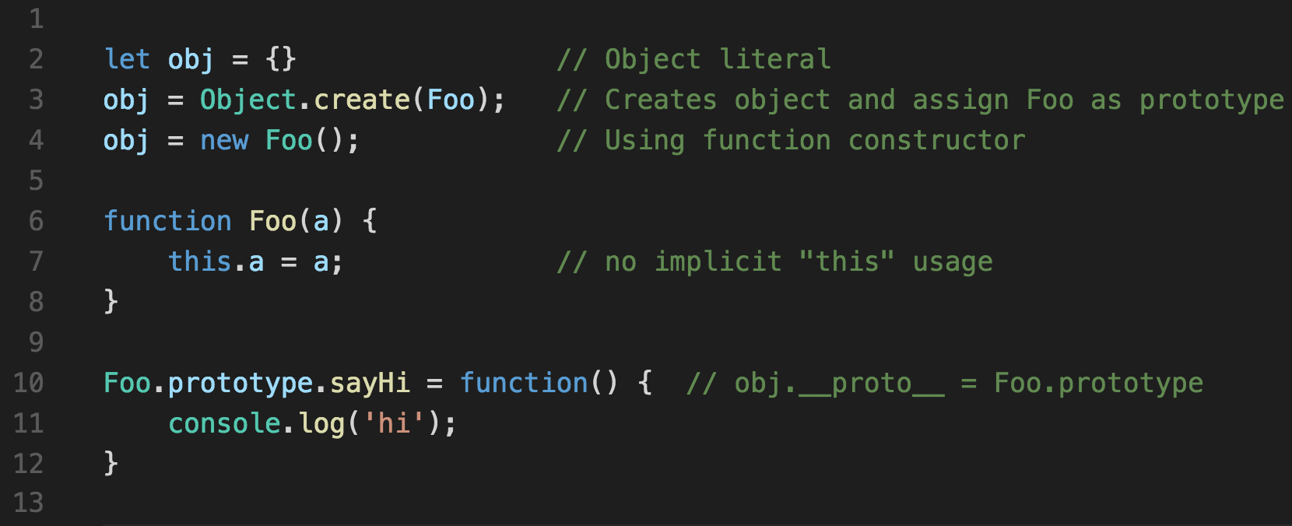
Object creation

Slide 27
Object prototype
A prototype
is a object that extends functionality of object being created
Prototype chaining
Searching for a object method implementation going through the chains of prototypes

Slide 28
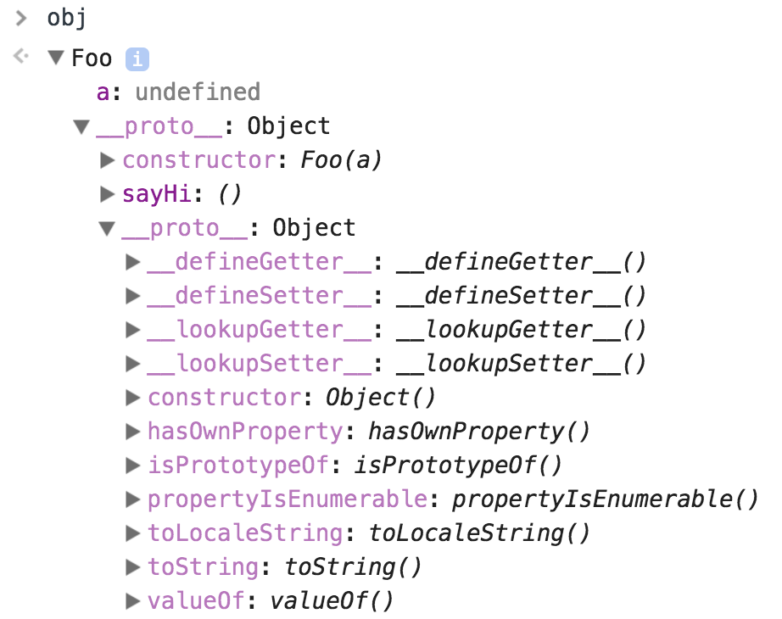
Prototype chaining

Slide 29
Type coercion
Type coercion
when the operands of an operator are different types, one of them will be converted to an "equivalent" value of the other operand's type
Best practice
Use === strict operator instead of ==

Slide 30
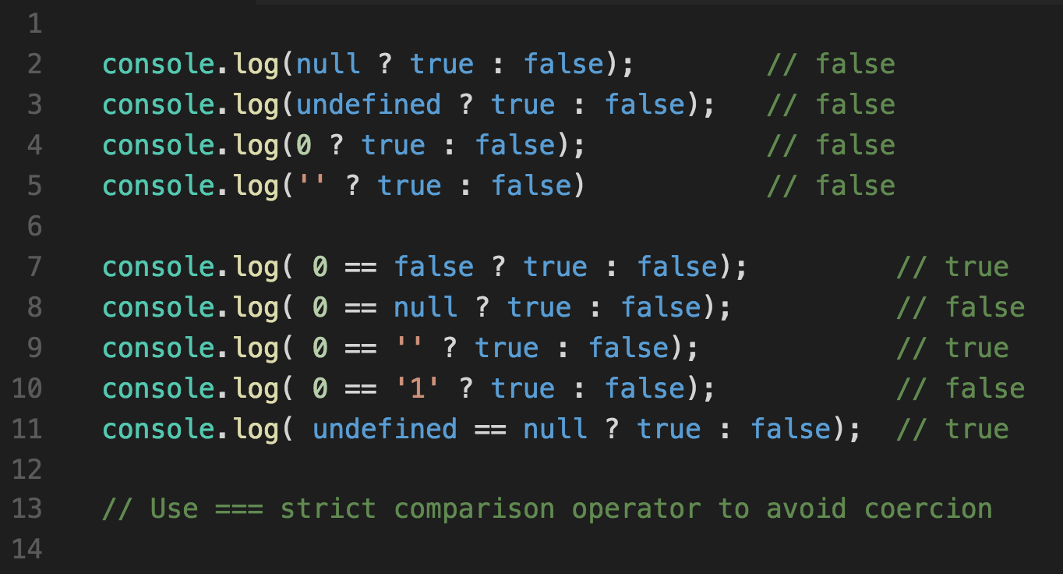
Type coercion
Notes:
Coercion - Type coercion means that when the operands of an operator are different types, one of them will be converted to an "equivalent" value of the other operand's type

Slide 31
Scope
Global scope
Function scope
Hoisting
Closures

Slide 32
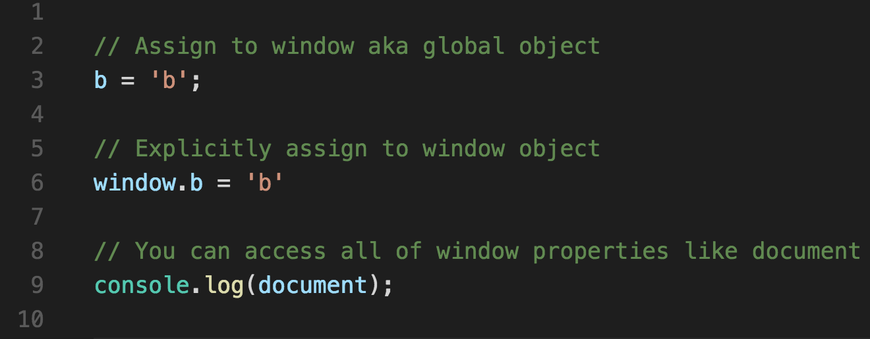
Global scope
In Browser global scope == window object
Best practice
Don’t define variables in global scope

Slide 33
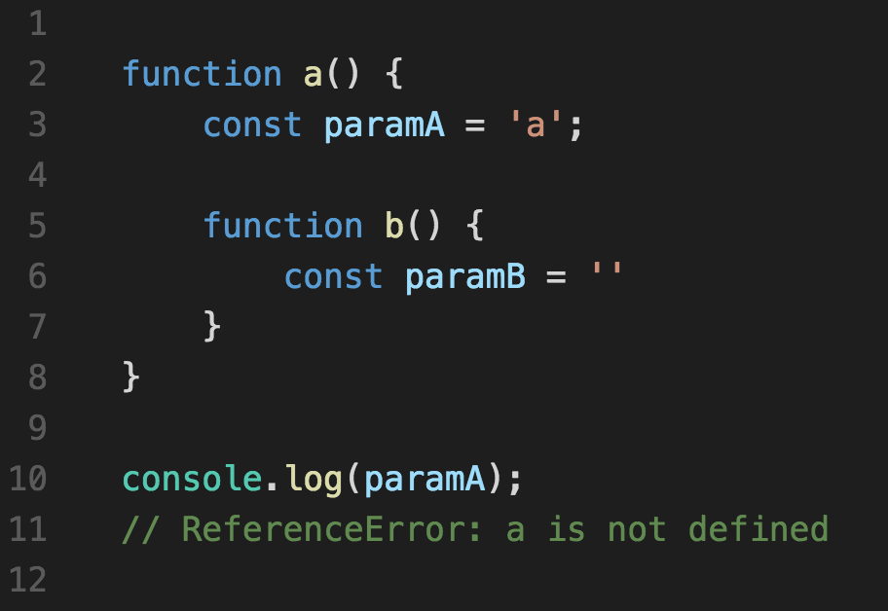
Function scope
Variables can be define in function scope
Scopes can be nested

Slide 34
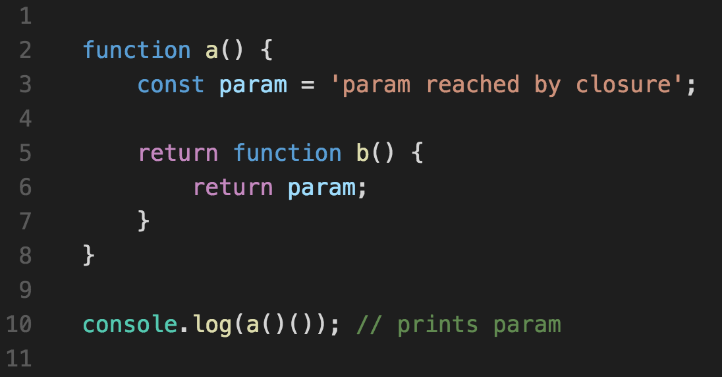
Closures
Closures - an inner function that has access to the outer (enclosing) function's variables scope chain

Slide 35
Hoisting
Hoisting
JavaScript interpreter's action of moving all variable and function declarations to the top of the current scope

Slide 36
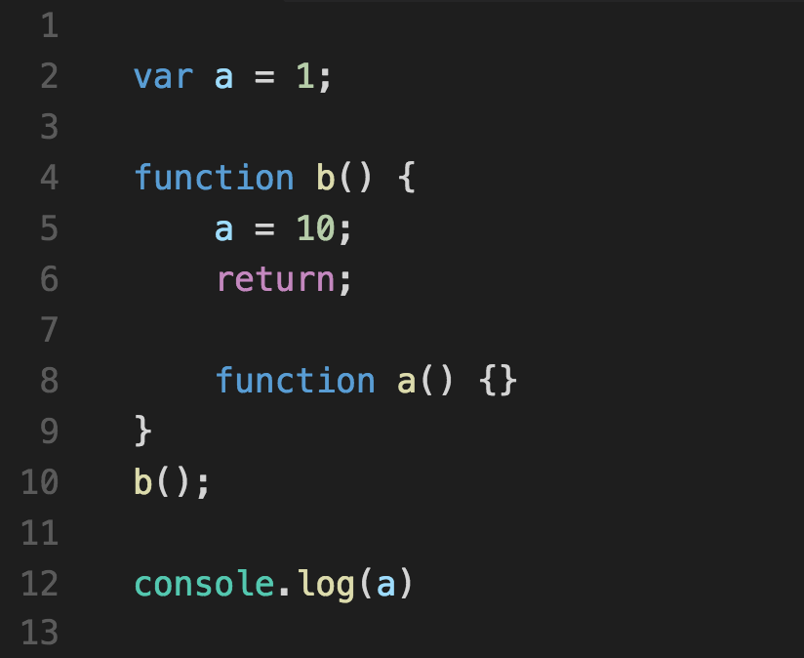
Hoisting example

Slide 37
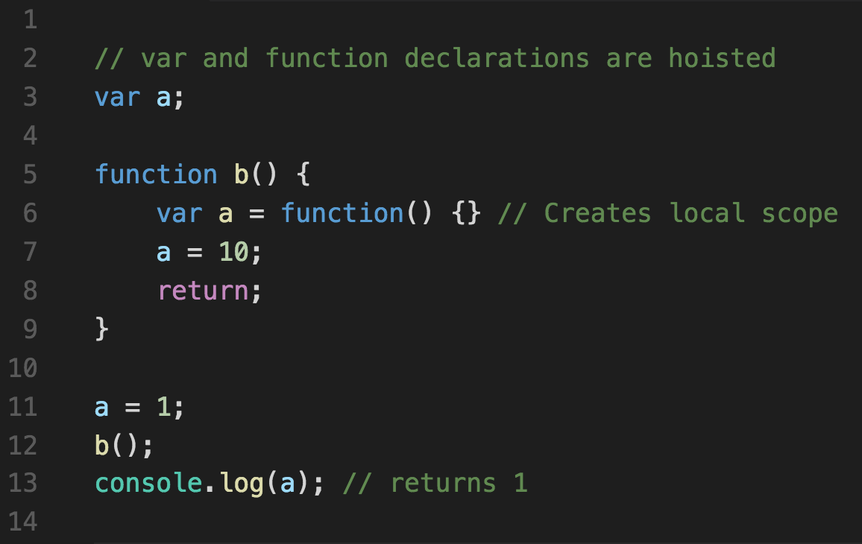
After hoisting applied

Slide 38
Browser related concepts
DOM, BOM models
Events
V8 engine event loop

Slide 39
JavaScript Implementation in Browser
The Core (ECMAScript)
The Document Object Model (DOM)
The Browser Object Model (BOM)
Notes:
BOM
Browser object model - an unformal term
The entire object structure which is accessible via window object
DOM
Document object model - a formal w3c term
A platform neutral interface that allows programs and scripts access and update document content
Browser APIs
Other browser objects exposed to JavaScript
Ajax call - is an asynchronous request initiated by the browser that does not directly result in a page transition.

Slide 40
BOM
Window - represents an open window in a browser
Document (aka DOM) - current HTML page and its content
Navigator - information about the browser
Screen - a special object for inspecting properties of the screen
History - list of pages the user has visited
Location - information about the current URL

Slide 41
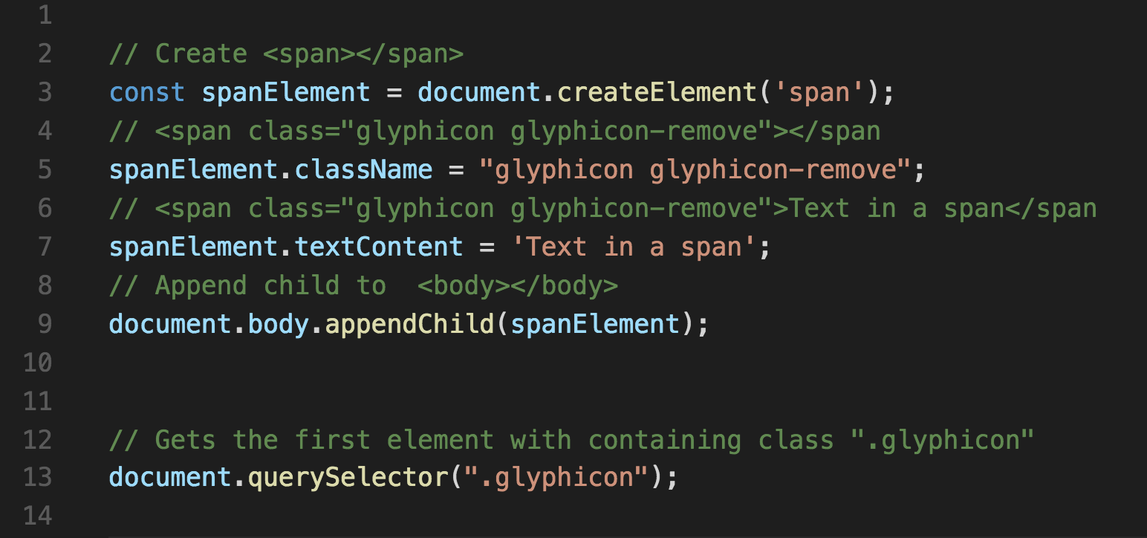
Manipulating DOM

Slide 42
Events
addEventLister(eventType, callback, phaseType)
Ex: eventType: ”click”, “mouseover”, ”dblclick”
Callback – function callback that has access to event object
PhaseType – capturing or bubbling, default bubbling
Event
e.target – target DOM element
e.preventDefault();
e.stopPropagation();

Slide 43
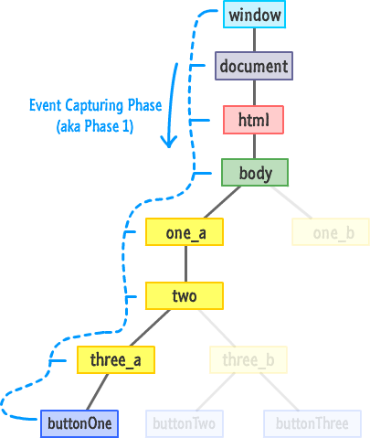
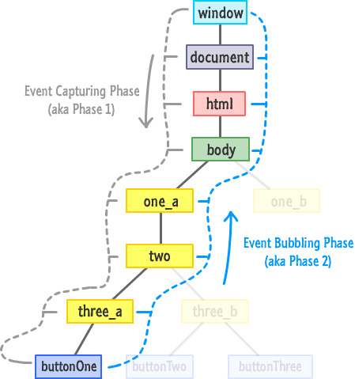
Event capturing phases

Slide 44
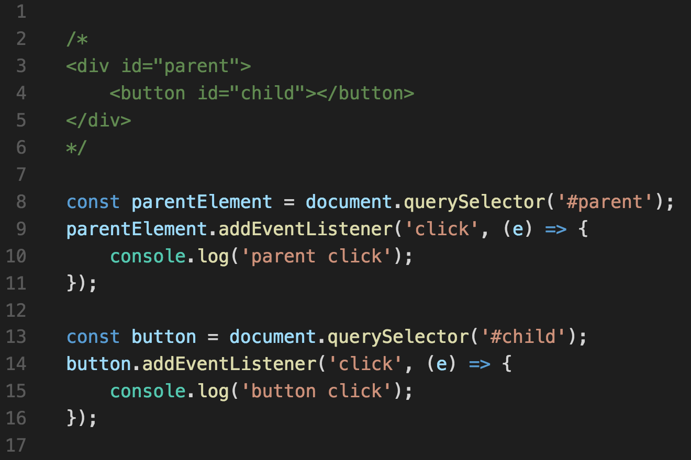
Example

Slide 45
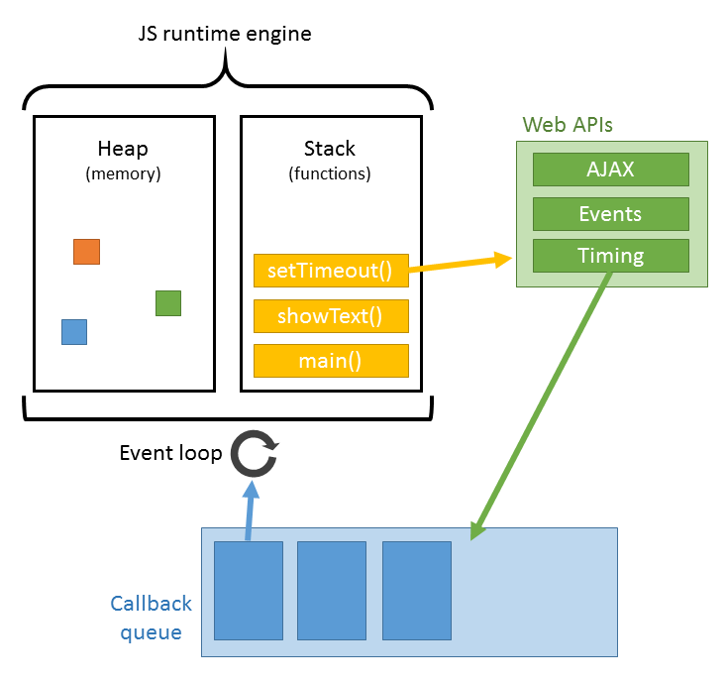
V8 engine and event loop

Slide 46
Q&A

Slide 47
Practice
todo-app-vanilla-features-starter
Add completion status to a task (can be a checkbox)
Implement completion logic as a toggle

Slide 48
Homework
Preconditions of React
todo-app-vanilla-features-finished
Extend functionality with multiple delete

Slide 49
Thank You
www.devbridge.com
Sourcery Academy

